Slide 1

Re ustin
Find a Bin. Share a Bin.

Slide 2
Goal:
Contribute to Austin’s Zero Waste efforts & make bulk recycling easier

Slide 3
The Problem
Have you ever needed to recycle a bunch of large boxes and ran out of space in your recycling bin? Can’t find a recycle center nearby, even with google maps?
Us too.

Slide 4
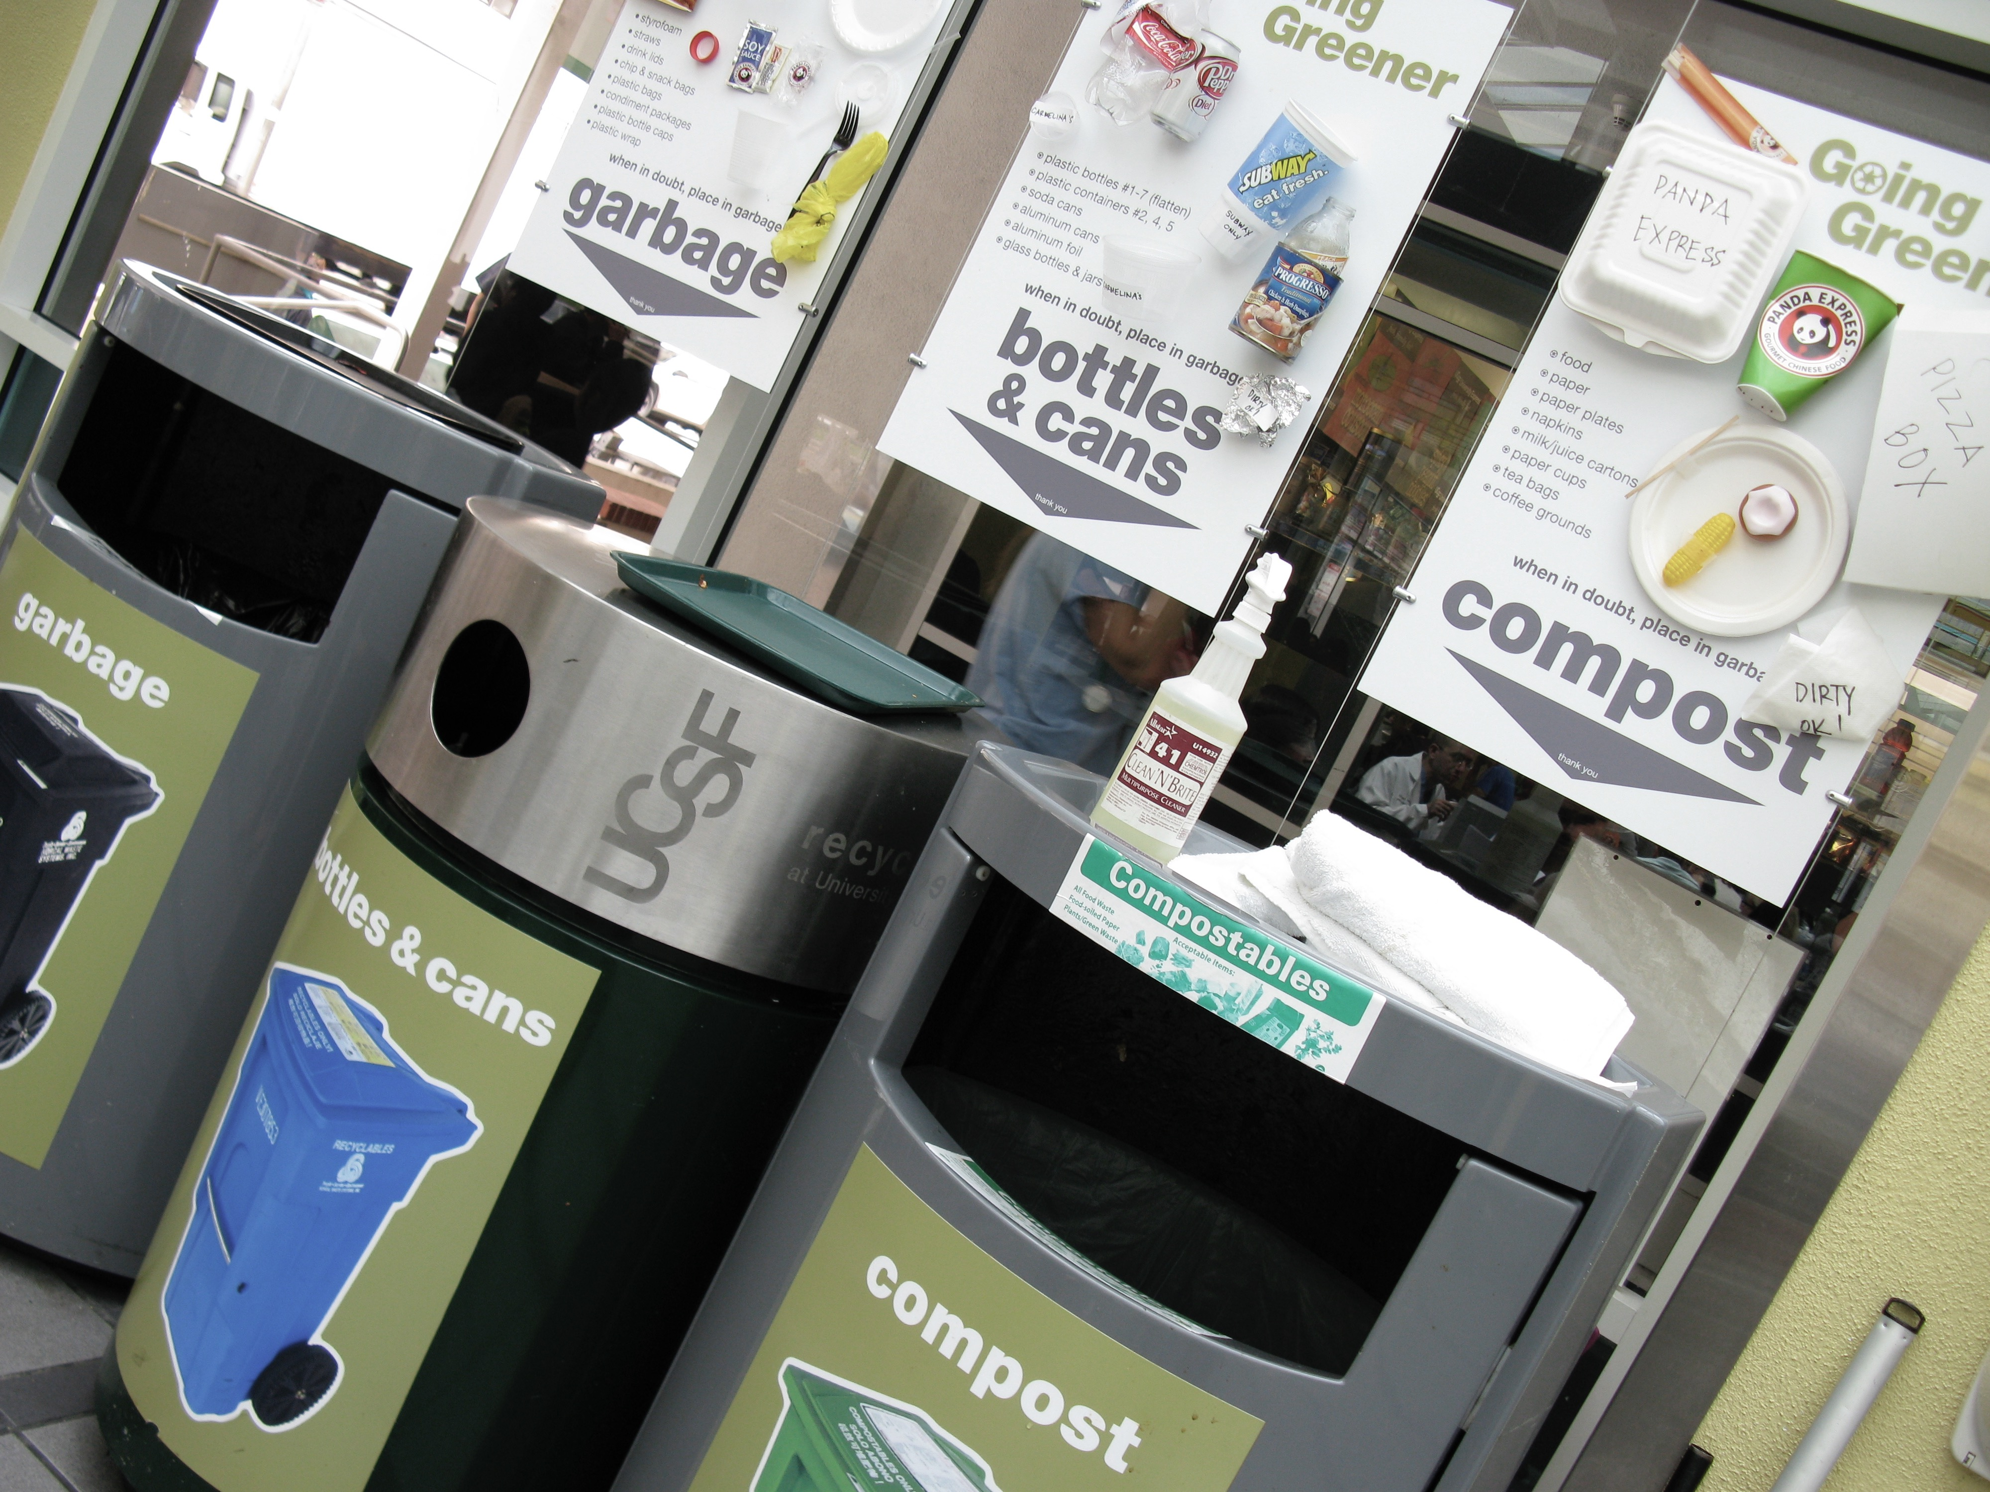
Create a website to crowdsource public bin locations for easier access & drop-off of large quantities of recyclable products
The Solution

Slide 5
How it Works
Look for a Bin
Find Centers Nearby
Contribute a Bin
Browser will find your location and any user generated points nearby
Browser will find your location and any user generated points nearby
Know a public recycle bin close to you? Add it to the map for other users

Slide 6


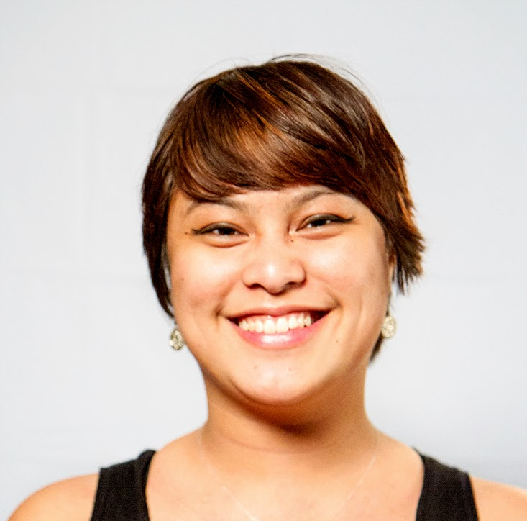
Megan King
Lisa Watkins
Rhea Rivera
Front-end Developer
Back-end Developer
Concept &
API Integration/Testing

Slide 7
Integrated Technologies
CSS Framework
APIs
Data Storage
Materialize
Google Maps Javascript
City of Austin
Socrata Open Data
Firebase

Slide 8
Looking Forward
Stored & Editable User Comments for Public Centers and User Bins
Public Bin Layer Toggles
Review a Bin
Social Bin Sharing
Accessing other City/State/Country Data for national usage

Slide 9
Q & A

